Slide 1
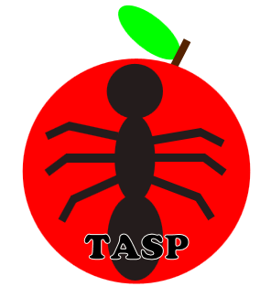
The Ant Simulator Project (TASP)
Midterm Presentation

Slide 2
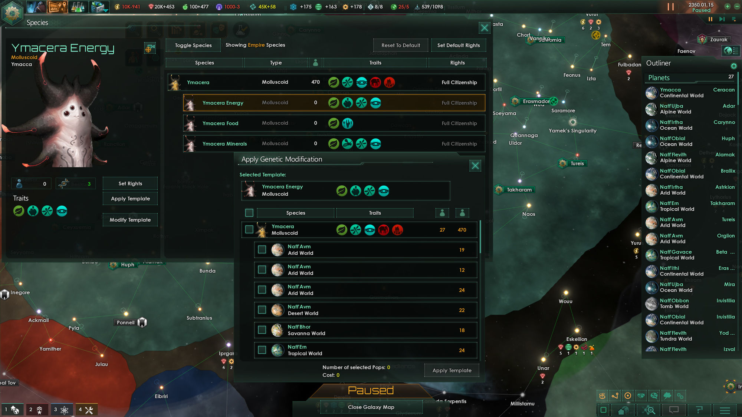
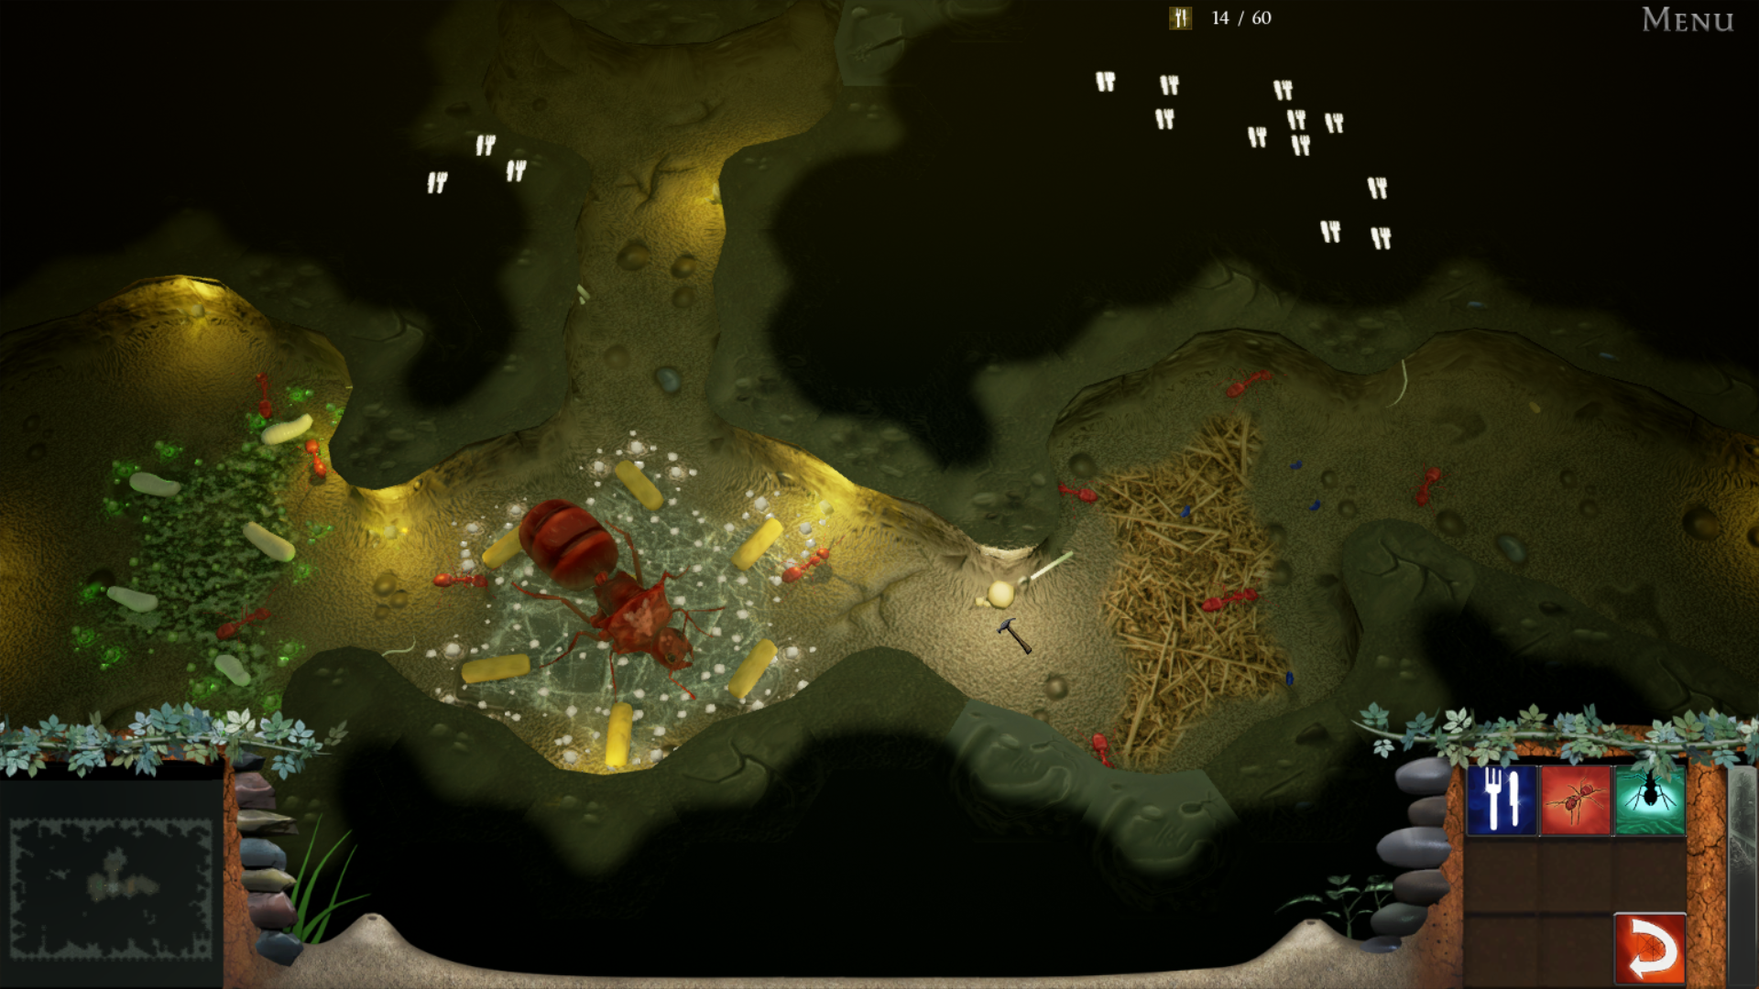
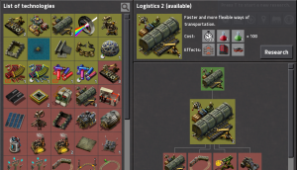
Vision
Empires of the undergrowth: general idea
Factorio: research system
Stellaris: territory & menus

Slide 3
Technologies

Slide 4
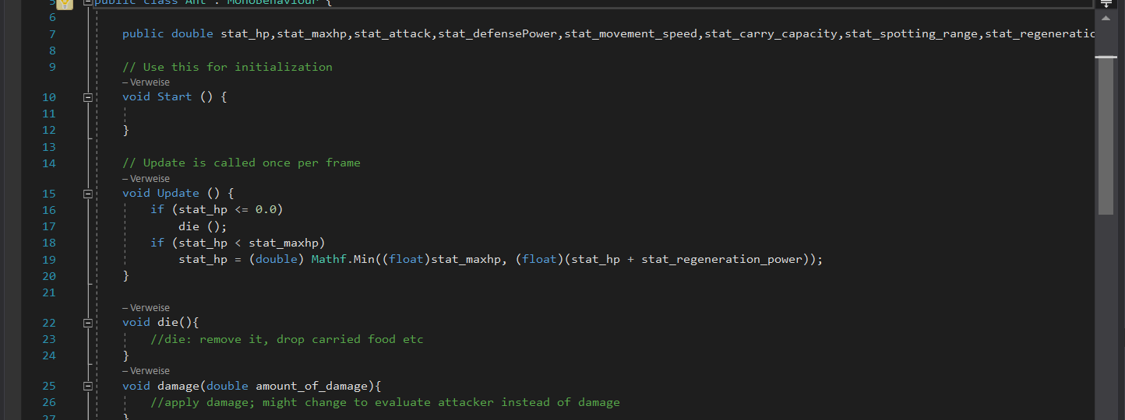


C#

Slide 5
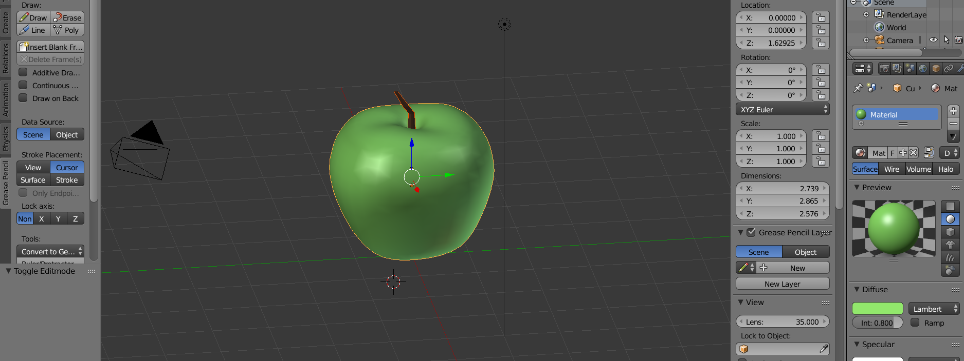

Blender

Slide 6
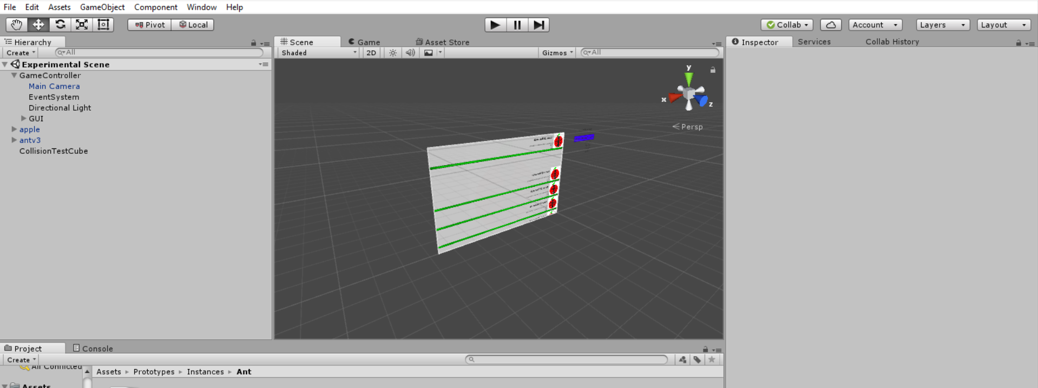

Unity

Slide 7
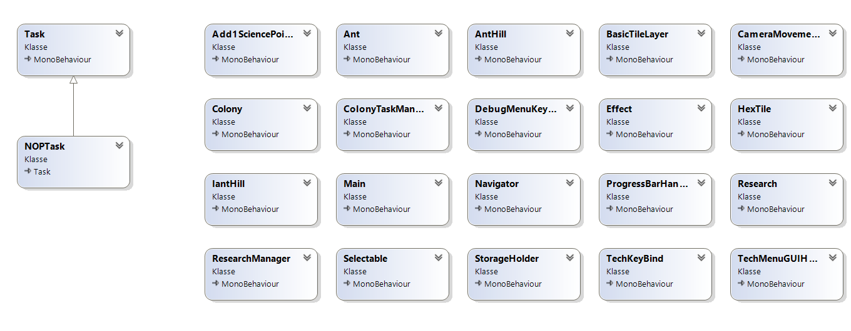
Class Diagram

Slide 8
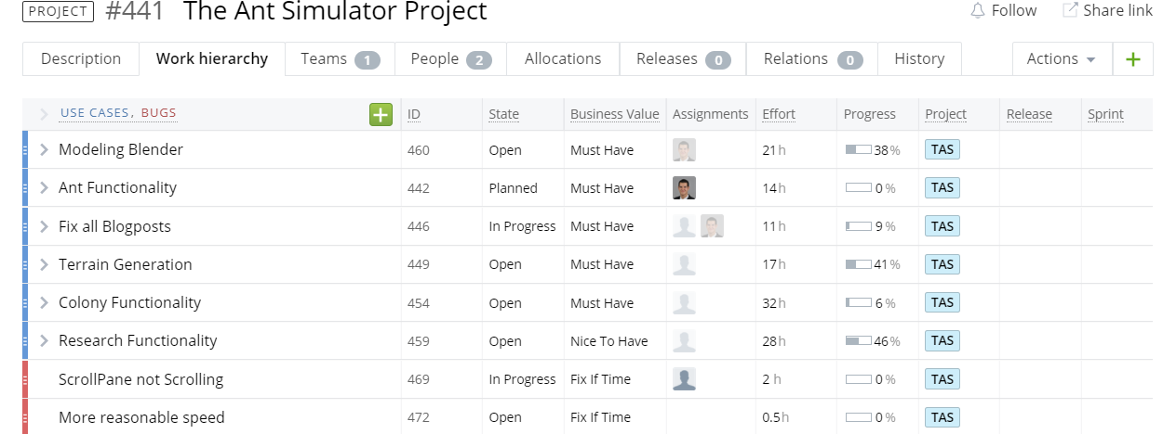
Target Process

Slide 9
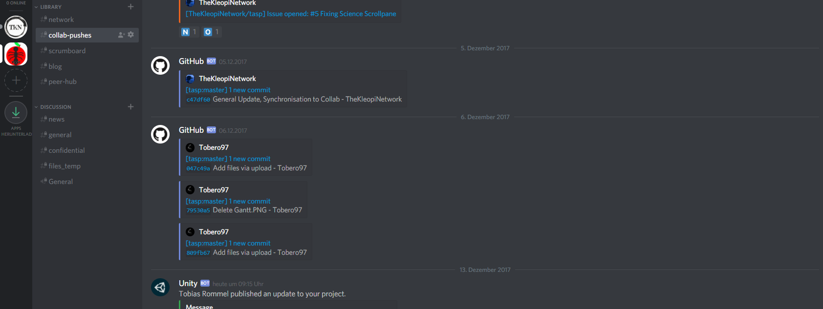

Discord (with Integrations)

Slide 10

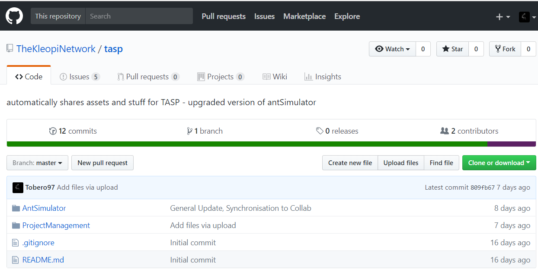
GitHub & Collab

Slide 11
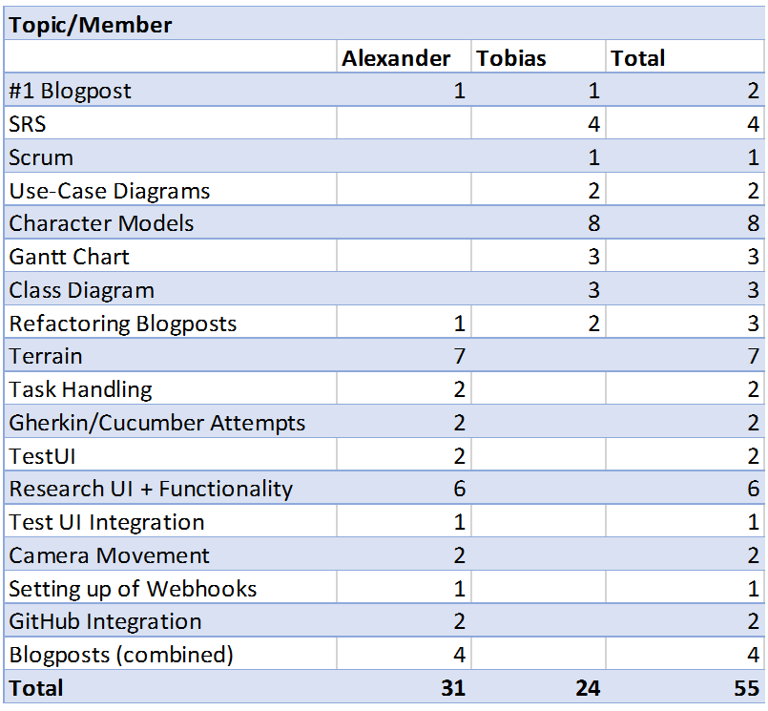
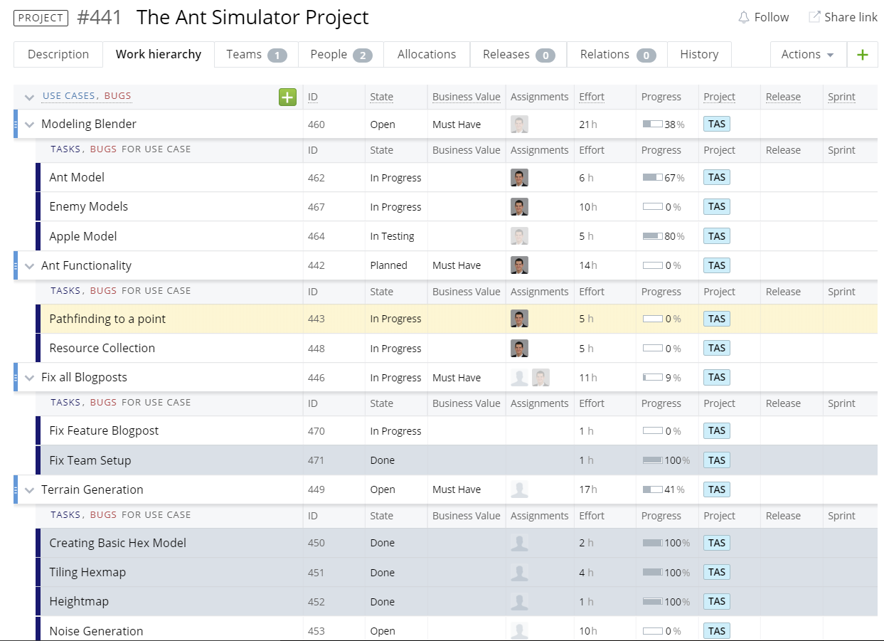
Timetracking

Slide 12
The Future
Character Movement
Resource Collection
Fighting System
Research
Demo

Slide 13
Demo

